Slide 1
Welcome to the experiment!
In this experiment you will need to classify pairs of insects and words or images as positive or negative.
To classify them you will need to press:
“G” for positive or
“F” for negative.
Once you press the “space bar” you will continue to the Practice trial instructions.
Press the “space bar” to continue.

Slide 2

Practice trial
As you read before, you will encounter an insect (word or image).
Mantis
G is positive F is negative
Press the “space bar” to continue.

Slide 3
Practice trial
Then you will see a word.
War
G is positive F is negative
Press the “space bar” to continue.

Slide 4
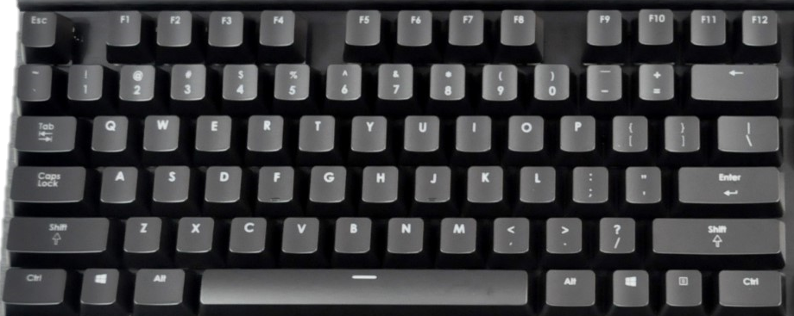
Practice trial
Once you see the word (e.g. War), you will be able to classify the insect (Mantis) and the word (War) as positive or negative
In order to classify them press:
“G” for positive or
“F” for negative.
And REMEMBER!
Be as fast and accurate as possible!
Press the “space bar” to start the practice trial.

Slide 5
Instructions
In this block you will see the name of an insect followed by a word.
Your objective is to classify this pairs as positive or negative
Press:
“G” for positive or
“F” for negative.
Be as fast and accurate as possible!
Good luck!
Press the “space bar” to start.

Slide 6
Instructions
In this block you will see an image of an insect followed by a word.
Your objective is to classify this pairs as positive or negative
Press:
“G” for positive or
“F” for negative.
Be as fast and accurate as possible!
Good luck!
Press the “space bar” to start.

